Slide 1
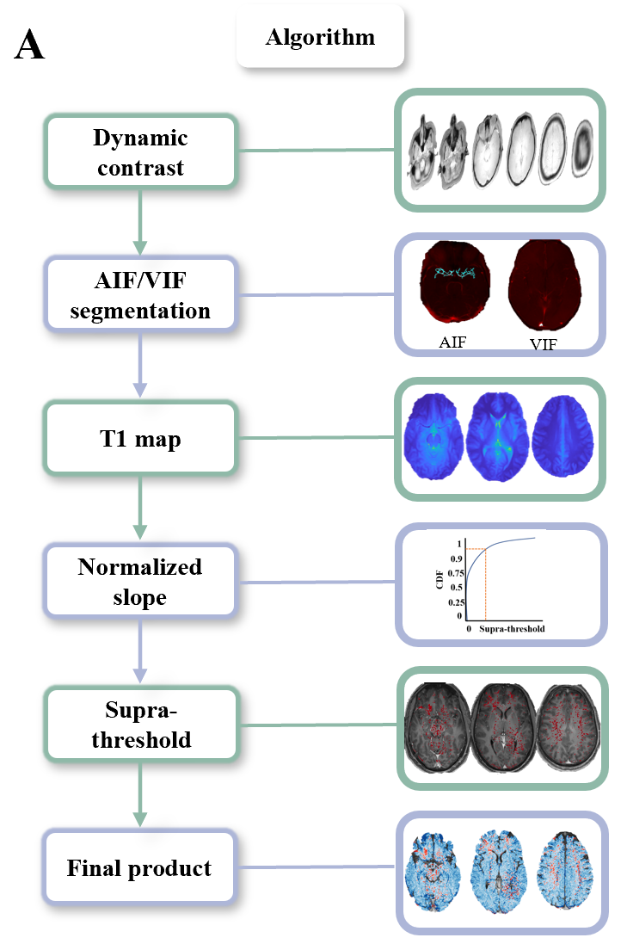
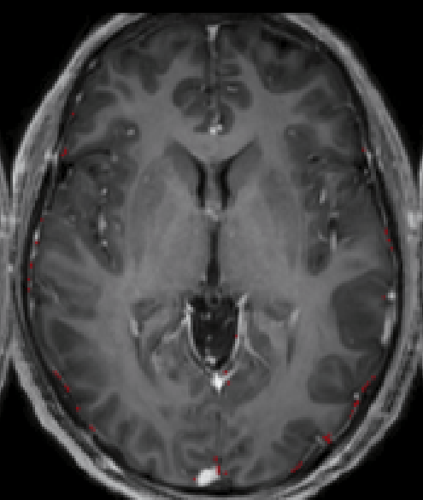
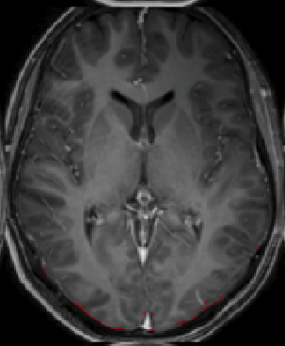
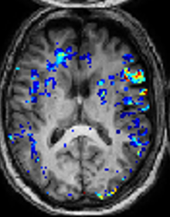
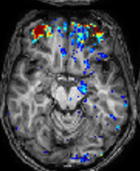
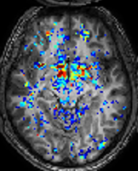
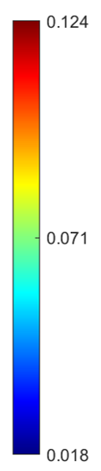


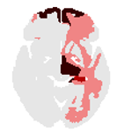

FIGURE 1: Epilepsy vs controls
A Method
B
C Controls
E Epilepsy
1 2
1 2 3
D
F
Figure 1 DCE-MRI reveals persistent BBBD in epileptic patients. . (A) BBBD analysis method. (B) Epileptic patients’ BBBD% and percent of areas above 2SD from the top 5% of controls statistics compared to controls. (C) Examples of controls BBBD maps. (D) Examples of controls regional maps. (E) Examples of patients with epilepsy 1 – Left temporal epilepsy. 2 – Left frontal epilepsy. 3- Generalized epilepsy. (F) Examples of patients with epilepsy regional maps.
Notes:
Epilepsy 1 – EA 0804 LFT
2 - MH 4108 LF
3 - WS_7206 G
Controls
1 – AN 0207
2 – HS 5404

Slide 2
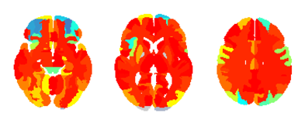
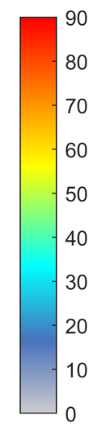
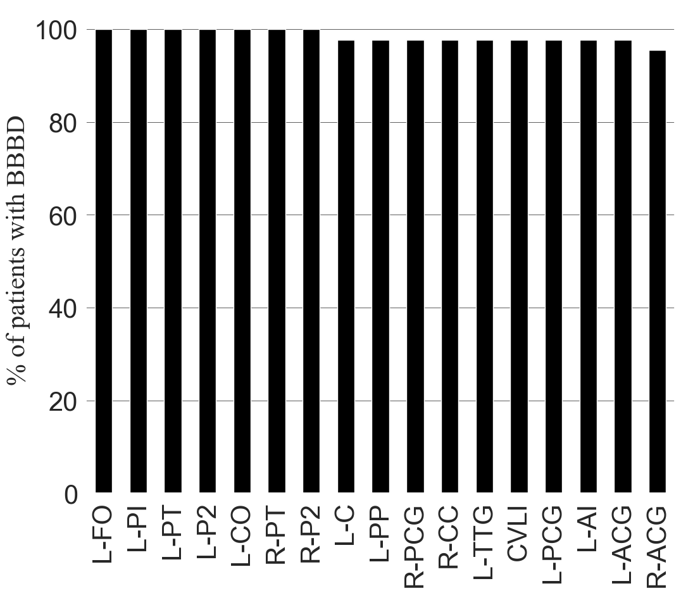
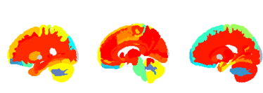
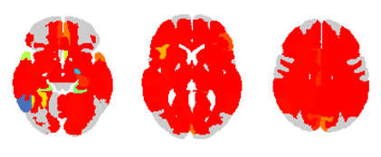
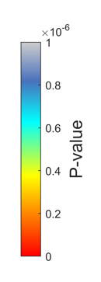
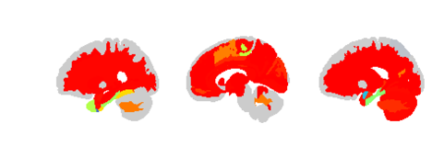
FIGURE 2: Regional analysis
A
C
Patients with BBBD, % all
B
Figure 2 . (A) Percent of epileptic patients with BBBD of each region. (B) Significant regions of epileptic patients compared to controls. (C) Regions with most % of patients with BBBD in slow model (p value < 1e-06). Areas in red are highly significant in both models. Regions legend: CVLI: Cerebellar Vermal Lobules I-V, L-ACG: Left anterior cingulate gyrus, L-AI: Left anterior insula, L-C: Left Caudate, L-CO: Left central operculum, L-FO: Left frontal operculum, L-PCG: Left posterior cingulate gyrus, L-P2: Left precuneus, L-PI: Left posterior insula, L-PP: Left planum polare, L-PT: Left planum temporale, L-TTG: Left transverse temporal gyrus, R-ACG: Right anterior cingulate gyrus, R-CC: Right calcarine cortex, R-PCG: Right posterior cingulate gyrus, R-P2: Right precuneus, R-PT: Right planum temporale
Notes:
Examples:
EA 0804
LL 0265
BT 3007 – left side
Optional:
AF7084 – linear and tofts diffuse
BA 5372 – linear G and tofts F

Slide 3
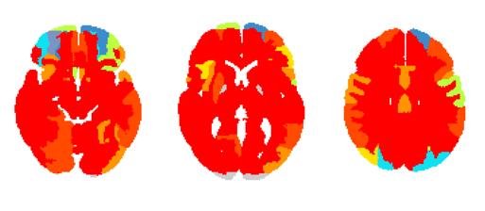
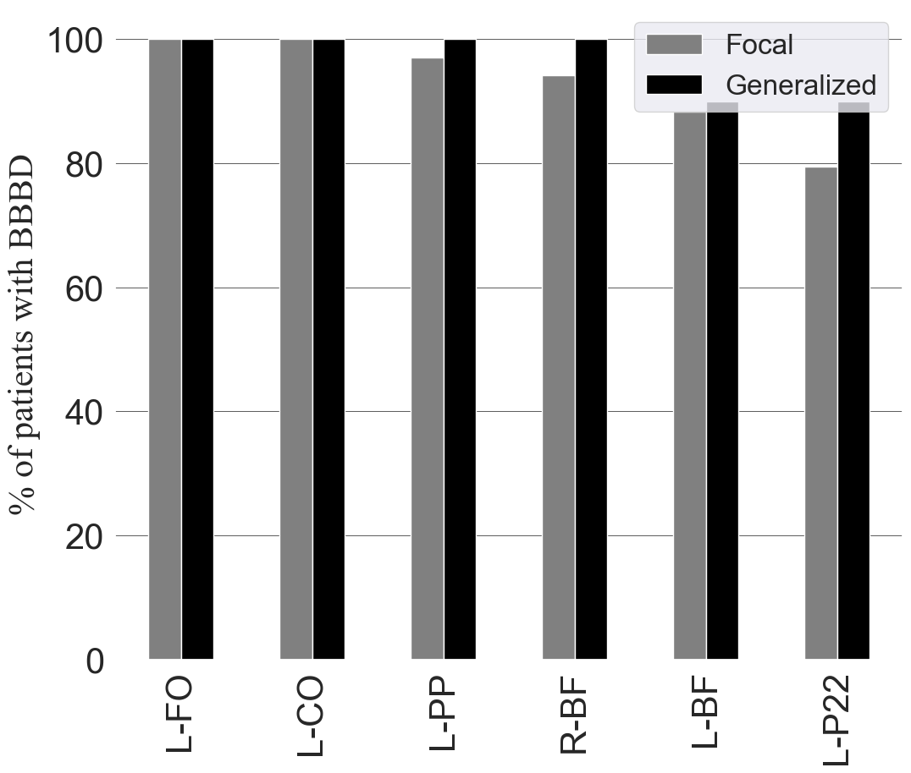
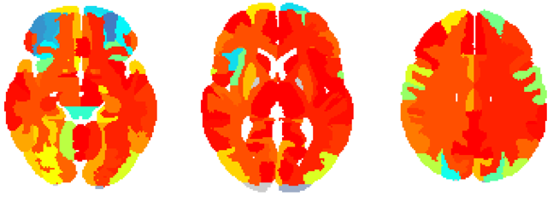
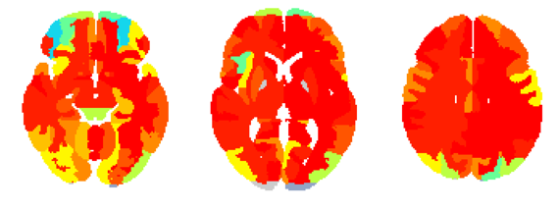
FIGURE 3: Focal vs Generalized
A Generalized
D
B Focal All
Patients with BBBD, % all
C Suspected temporal
Figure 3 Similar BBBD behavior of slow and fast models. (A) Percent of focal epileptic patients in each region. (B) Percent of generalized epileptic patients in each region. (C) Regions with most % of patients with BBBD in fast model (p value < .01). (D) Statistics of focal and generalized epileptic patients. Regions legend: L-BF: Left Basal Forebrain, L-CO: Left central operculum, L-FO: Left frontal operculum, L-PP: Left planum polare, L-P22: Left Putamen, R-BF: Right Basal Forebrain
Notes:
G
AE 2898
DJ 5694
SH 1959
F
VA 6538
LL 0265
TA 4648

Slide 4
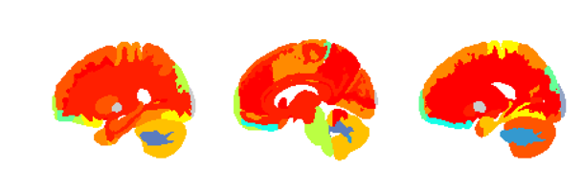
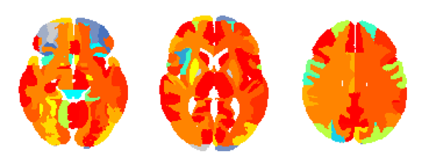
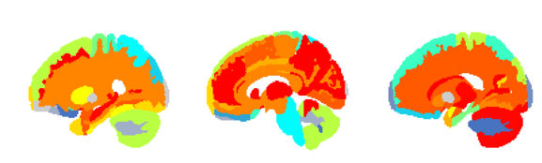
FIGURE 4: Frontal focal epilepsy
A Suspected Frontal
C
Patients with BBBD, % all
B Temporal
D
Figure 4 Focal regions are characterized with more BBBD. (A) Patients with temporal epilepsy compared to other epileptic patients in temporal regions. (B) Statistics of temporal and frontal focal epileptic patients in temporal regions. (C) Patients with frontal epilepsy compared to other epileptic patients in frontal regions. (D) Patients with frontal epilepsy compared to other epileptic patients in frontal regions.
N
Frontal epilepsy = 15
Rest epilepsy = 25
N
Temporal epilepsy = 13
Rest epilepsy = 27

Slide 5
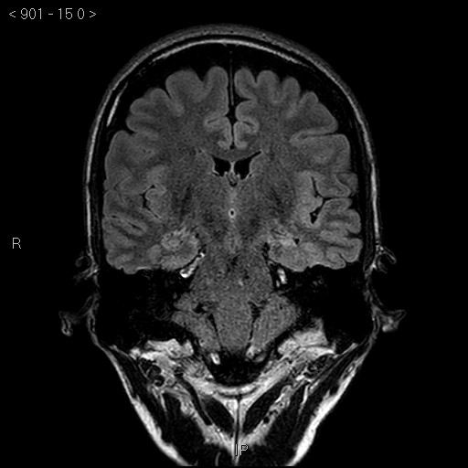
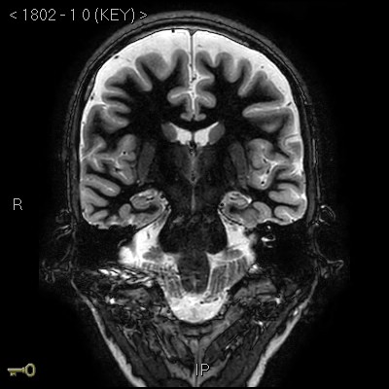
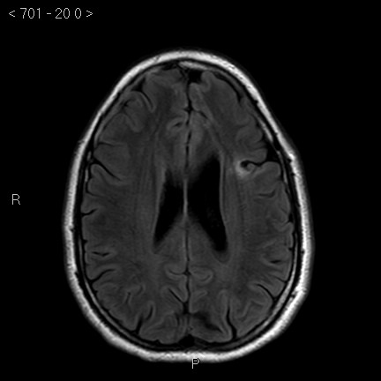
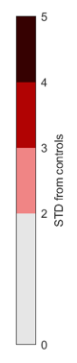
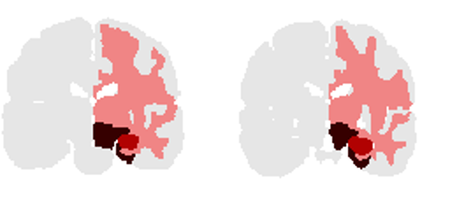

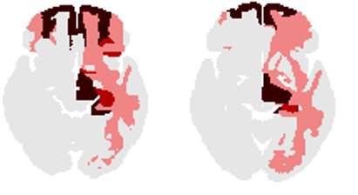
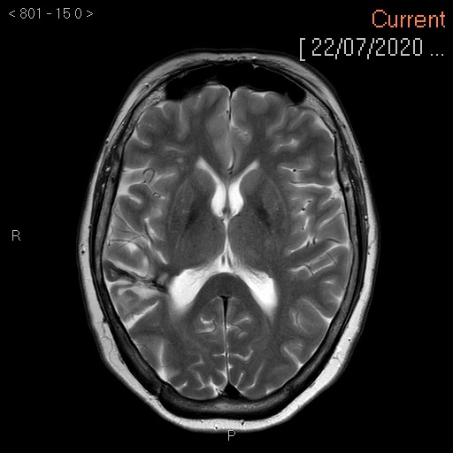
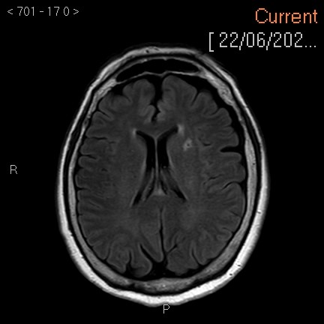
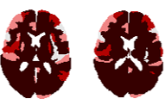


FIGURE 5: Lesion and BBBD
A Left Hippocampal Sclerosis: 35 yo man, focal epilepsy with impaired awareness, secondary generalization
B Frontal lode epilepsy: 33yo man, EEG: normal
C Frontal lobe Epilepsy: 55yo woman, EEG: frontal temporal right
D M/P Cortical Dysplasia: 57yo woman, EEG: Letf fronto-temporal
Notes:
1 - MH_4108
2 - BT_3007
3 - TA_4648
4 - EA_0804

Slide 6
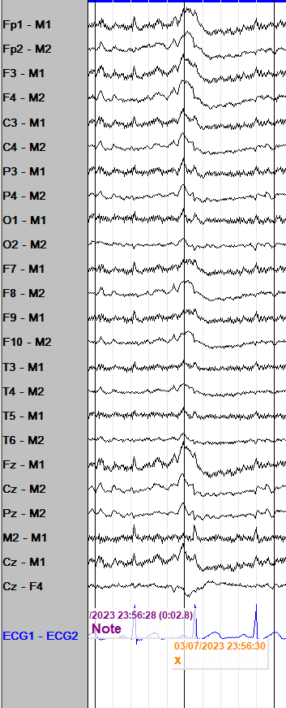
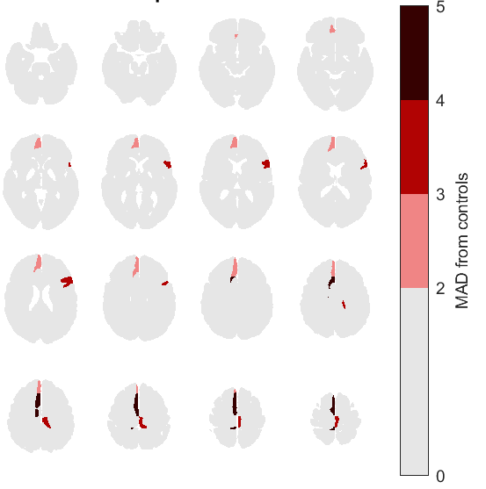
Time for translation: Preliminary (unpublished) results
Patient #1: 28-year-old male, “seizure-like episodes” during sleep. Meds: carbamazepine, divalproex, perampanel.
EMU: Complex and brief hypermotor events, vocalizing out of sleep, left arm extension and right arm flexion. Focal to bilateral tonic-clonic seizures. LTM-EEG: Interictal bifrontal spikes Rt>Lt. Ictal: right frontal midline vs bifrontal.
MRI: Non-lesional
With Ben Whatley, Dalhousie Univ / NSHA (3T GE)
Notes:
Left: Referential montage to ipsilateral mastoid (M1, M2)- bifrontal low amplitude sharp and slow wave maximal over Fp2, F4, F8, Fz
Right: Common average montage- bifrontal spikes and sharp waves
I did not receive examples for ictal patterns

Slide 7
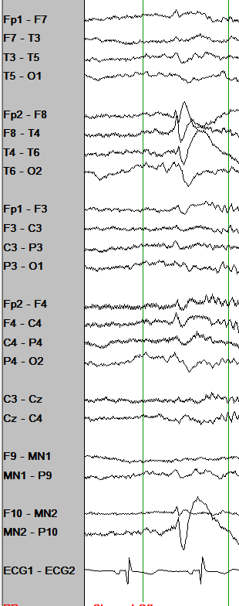
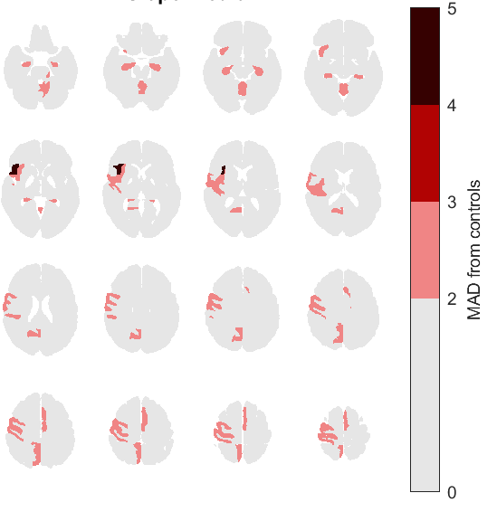
Time for translation: Preliminary (unpublished) results
Patient #2: 24-year-old female, possible right mesial temporal lobe epilepsy. Meds: brivaracetam, lamotrigine, perampanel
Interictal EEG: Right anterior temporal spikes. EMU: focal to bilateral tonic clonic seizures, semiology rMTLE
LTM-EEG: Ictal: low amplitude rhythmic delta evolving over the right anterior and mid-temporal regions
MRI: non-lesional .
With Ben Whatley, Dalhousie Univ / NSHA
Notes:
An example for the regional comparison output: Mainly frontal areas

Slide 8
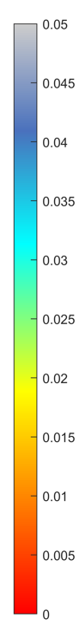
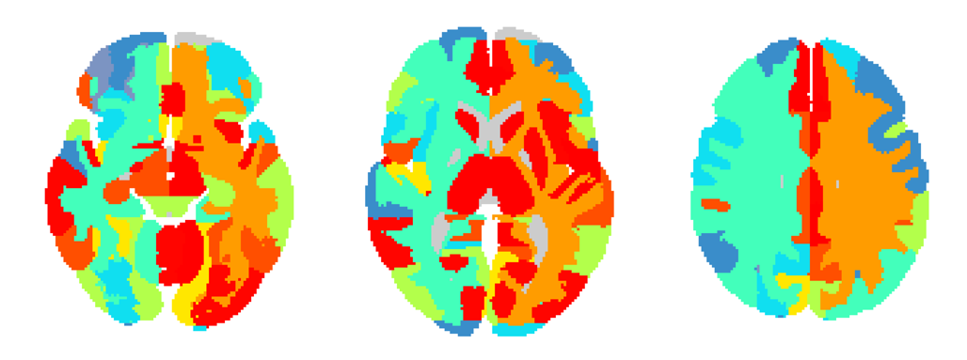
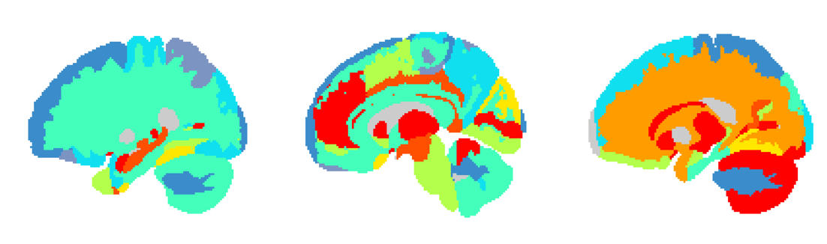
FIGURE 4: Temporal focal epilepsy
A
B
Patients with BBBD, % all
Figure 4 Focal regions are characterized with more BBBD. (A) Patients with temporal epilepsy compared to other epileptic patients in temporal regions in fast model. (B) Patients with temporal epilepsy compared to other epileptic patients in temporal regions in slow model. Temporal areas; 0: Left ITG inferior temporal gyrus, 1: Left MTG middle temporal gyrus, 2: Left PT planum temporale, 3: Left STG superior temporal gyrus, 4: Left TMP temporal pole, 5: Left TTG transverse temporal gyrus, 6: Right ITG inferior temporal gyrus, 7: Right MTG middle temporal gyrus, 8: Right PT planum temporale, 9: Right STG superior temporal gyrus, 10: Right TMP temporal pole, 11: Right TTG transverse temporal gyrus. (C) Patients with frontal epilepsy compared to other epileptic patients in frontal regions in fast model. (D) Patients with frontal epilepsy compared to other epileptic patients in frontal regions in slow model. Frontal areas; 0: Left FO frontal operculum, 1: Left FRP frontal pole, 2: Left MFC medial frontal cortex, 3: Left MFG middle frontal gyrus, 4: Left MSFG superior frontal gyrus medial segment, 5: Left OpIFG opercular part of the inferior frontal gyrus, 6: Left OrIFG orbital part of the inferior frontal gyrus, 7: Left SFG superior frontal gyrus, 8: Left TrIFG triangular part of the inferior frontal gyrus, 9: Right FO frontal operculum, 10: Right FRP frontal pole, 11: Right MFC medial frontal cortex, 12: Right MFG middle frontal gyrus, 13: Right MSFG superior frontal gyrus medial segment, 14: Right OpIFG opercular part of the inferior frontal gyrus, 15: Right OrIFG orbital part of the inferior frontal gyrus, 16: Right SFG superior frontal gyrus, 17: Right TrIFG triangular part of the inferior frontal gyrus.
N
Frontal epilepsy = 15
Rest epilepsy = 25
N
Temporal epilepsy = 13
Rest epilepsy = 27

Slide 9
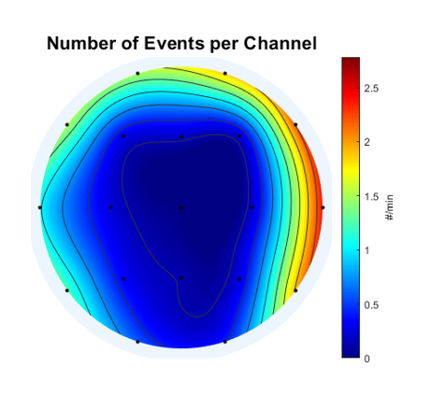
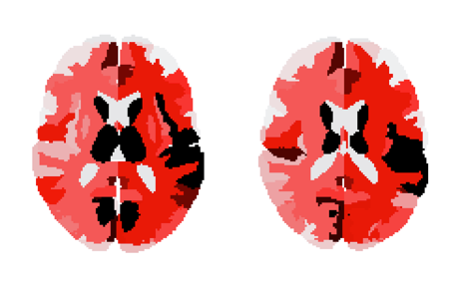
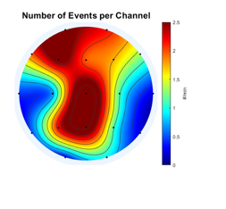
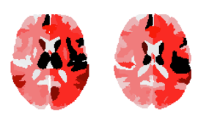
TA_4648
EA_0804

Slide 10
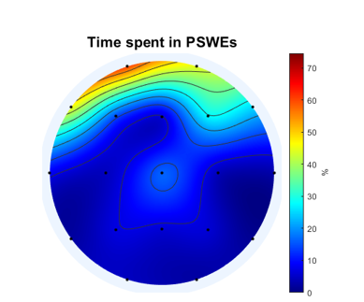
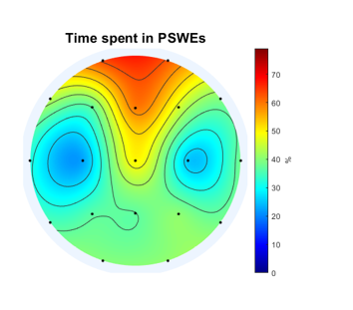
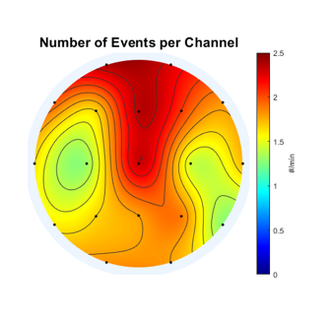
MH_4108
BT_3007
TA_4648
EA_0804

Slide 11
FIGURE 4: Frontal and temporal focal epilepsy
A Fast
C Fast
B Slow
D Slow
Figure 4 Focal regions are characterized with more BBBD. (A) Patients with temporal epilepsy compared to other epileptic patients in temporal regions in fast model. (B) Patients with temporal epilepsy compared to other epileptic patients in temporal regions in slow model. Temporal areas; 0: Left ITG inferior temporal gyrus, 1: Left MTG middle temporal gyrus, 2: Left PT planum temporale, 3: Left STG superior temporal gyrus, 4: Left TMP temporal pole, 5: Left TTG transverse temporal gyrus, 6: Right ITG inferior temporal gyrus, 7: Right MTG middle temporal gyrus, 8: Right PT planum temporale, 9: Right STG superior temporal gyrus, 10: Right TMP temporal pole, 11: Right TTG transverse temporal gyrus. (C) Patients with frontal epilepsy compared to other epileptic patients in frontal regions in fast model. (D) Patients with frontal epilepsy compared to other epileptic patients in frontal regions in slow model. Frontal areas; 0: Left FO frontal operculum, 1: Left FRP frontal pole, 2: Left MFC medial frontal cortex, 3: Left MFG middle frontal gyrus, 4: Left MSFG superior frontal gyrus medial segment, 5: Left OpIFG opercular part of the inferior frontal gyrus, 6: Left OrIFG orbital part of the inferior frontal gyrus, 7: Left SFG superior frontal gyrus, 8: Left TrIFG triangular part of the inferior frontal gyrus, 9: Right FO frontal operculum, 10: Right FRP frontal pole, 11: Right MFC medial frontal cortex, 12: Right MFG middle frontal gyrus, 13: Right MSFG superior frontal gyrus medial segment, 14: Right OpIFG opercular part of the inferior frontal gyrus, 15: Right OrIFG orbital part of the inferior frontal gyrus, 16: Right SFG superior frontal gyrus, 17: Right TrIFG triangular part of the inferior frontal gyrus.
N
Frontal epilepsy = 11
Rest epilepsy = 18
N
Temporal epilepsy = 9
Rest epilepsy = 20

Slide 12
Frontal Vs Rest

Slide 13
Frontal Vs Rest

Slide 14
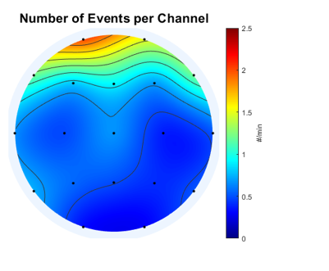
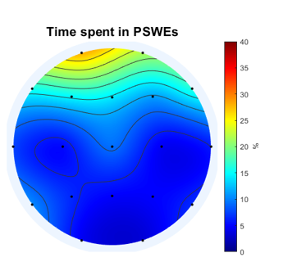
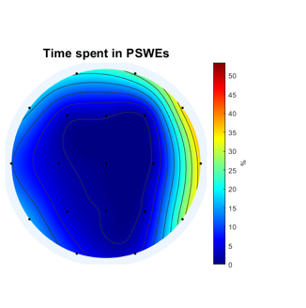
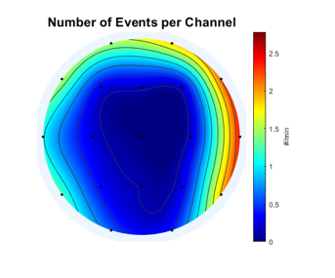
FIGURE 5: PSWE and BBBD
ME 4933
TA 4648

Slide 15
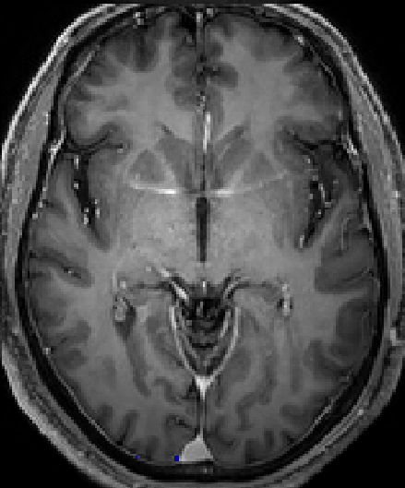


HY9719 Slow Fast

Slide 16
FIGURE 4: Temporal vs Frontal
D
A
B
C
D
N
Temporal epilepsy = 8
Rest epilepsy = 26
N
Frontal epilepsy = 10
Rest epilepsy = 24
Notes:
Theories:
* Generalized is a type of focal

Slide 17
FIGURE 4: Temporal vs Frontal
D
A
B
C
D
N
Temporal areas = 10
Other areas = 126
Notes:
Theories:
* Generalized is a type of focal

Slide 18
N
Patients with lesions– 13
Notes:
Theories:
* Generalized is a type of focal

Slide 19





















A CONTROLS
C STATISTICS
0 slow 0.1
Fast
0 fast 0.1
Slow
D METHOD
B EPILEPSY
PWE 1 2 3 4
Fast
STD above controls
Slow
Figure 1 DCE-MRI reveals persistent BBBD in epileptic patients. (A) Examples of controls without BBBD, with fast BBBD and slow BBBD. (D) Examples of patients with epilepsy without BBBD, with fast BBBD and slow BBBD and both fast and slow BBBD. (C) Epileptic patients' statistics compared to controls. (D) BBBD analysis method
Notes:
CONTORLS:
PN_8563
HS_5404
CM_8261
Epilepsy
IE_2899
BT_3007
MB_1437

